Slide 1
Paper id:icscss-495
2nd International Conference on Sustainable Computing and Smart Systems (ICSCSS 2024)
PRECOCIOUS DIAGNOSIS OF ALZHEIMER’S DISEASE USING MACHINE LEARNING
Presented by : Shaik Neeha Yasmin
LAKIREDDY BALI REDDY COLLEGE OF ENGINEERING
(An Autonomous Institution Since 2010)
Affiliated to JNTUK, Kakinada

Slide 2
Contents
1 Abstract
2 Introduction
3 Literature Review
4 Methodology
6 Architecture diagram
5 Visualization and Results
7 Conclusion
8 Future Scope

Slide 3
Abstract
Alzheimer's disease poses a profound challenge in neurodegenerative research due to memory loss and cognitive decline. Our Random Forest model, applied to the OASIS dataset, achieved a 90.6% balanced accuracy, demonstrating robustness. Key findings highlighted neural features' importance and neuroimaging biomarkers in disease categorization. Machine learning enhances diagnostic accuracy, especially for early detection. This research underscores machine learning's potential to advance Alzheimer's diagnostics, urging the integration of advanced technologies for improved patient outcomes and understanding of neural mechanisms.

Slide 4
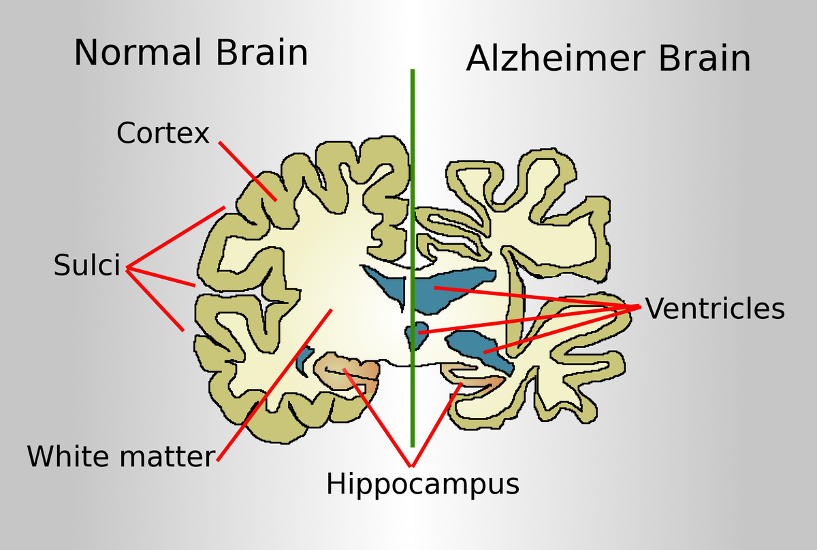
INTRODUCTION
Alzheimer's disease (AD) involves progressive cognitive decline and memory impairment, posing a serious public health threat.
Early and precise diagnosis is crucial for tailored patient care and timely interventions.
Machine learning methods show promise in early AD identification, especially with integrated datasets like OASIS and ADNI.
Combined use of ADNI and OASIS datasets achieved a balanced accuracy of 90.6%, measured by the Matthews correlation coefficient.
Fig(a)

Slide 5
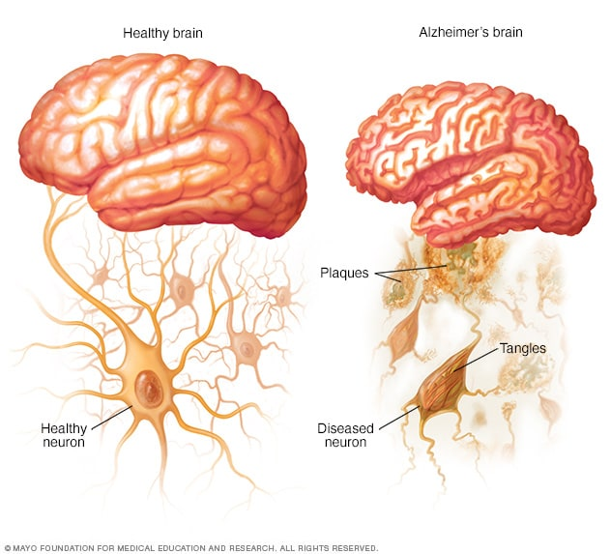
Our study focuses on the OASIS dataset alone, achieving a similar accuracy rate of 90.6% using a Random Forest model.
Methodology included thorough preprocessing, exploratory data analysis, and hyperparameter adjustment during model training.
Key findings highlight the importance of neuroimaging biomarkers, such as hippocampus features, in categorization, emphasizing customized diagnostic strategies.
The study demonstrates the potential of machine learning to improve early AD detection and patient care, advancing the field and informing future interventions and healthcare policies.
Fig(b)

Slide 6
LITERATURE REVIEW
The Growing Need for Early Alzheimer's Diagnosis:
Alzheimer's disease (AD) is a neurodegenerative disorder characterized by progressive cognitive decline and memory loss, predominantly affecting the elderly.
Early diagnosis is crucial as it allows for timely medical intervention, potentially slowing disease progression and improving patient outcomes.
Machine Learning's Role in Alzheimer's Diagnosis:
Machine learning (ML) techniques are increasingly applied to medical diagnostics, including Alzheimer's disease.
ML models can analyze complex datasets to identify patterns and markers indicative of early AD.
Methods such as Random Forest, Support Vector Machines, and neural networks are commonly employed due to their ability to handle high-dimensional data and provide accurate predictions.

Slide 7
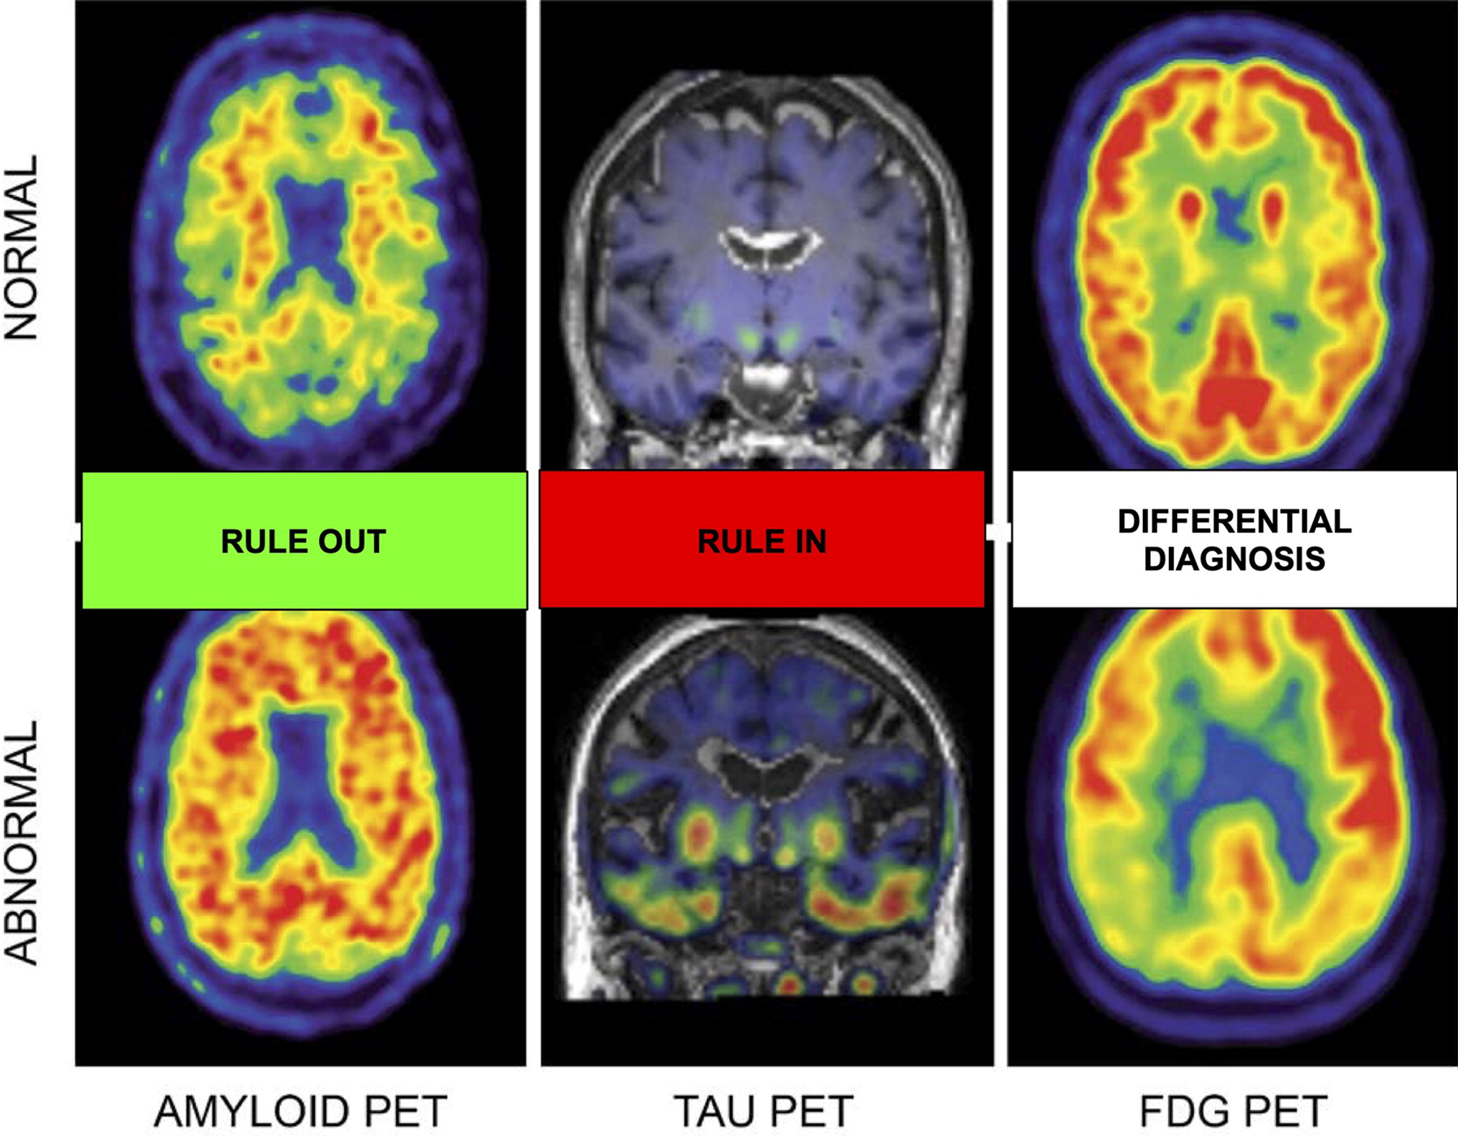
The Importance of Neuroimaging Biomarkers:
Neuroimaging biomarkers such as hippocampal volume and cortical thickness differentiate Alzheimer's disease through brain structure assessments. Their integration into Random Forest ML models improves accuracy in detecting early stages of AD, thereby enhancing personalized care.
Evaluation Metrics for Diagnostic Models:
Accuracy, Precision, and Recall evaluate the correctness of positive predictions and their completeness. AUC-ROC summarizes the model's ability to discriminate between AD and healthy individuals.
Fig(c)

Slide 8
METHODOLOGY
The OASIS dataset facilitates open access to MRI data for Alzheimer's research, encompassing both cross-sectional and longitudinal studies with comprehensive demographic and clinical data.
Neuroimaging metrics like MMSE, CDR, eTIV, nWBV, and ASF are pivotal in analyzing brain structure and function, aiding in disease characterization and biomarker discovery.
Random Forest was selected for its ability to handle diverse data types and large datasets, using ensemble learning to mitigate overfitting and improve predictive accuracy.
Hyperparameter optimization via GridSearchCV fine-tuned model parameters (number of estimators, maximum depth), enhancing performance in Alzheimer's disease classification.
Model evaluation through recall, precision, accuracy, and confusion matrix analysis validated its effectiveness in predicting and managing Alzheimer's disease.

Slide 9
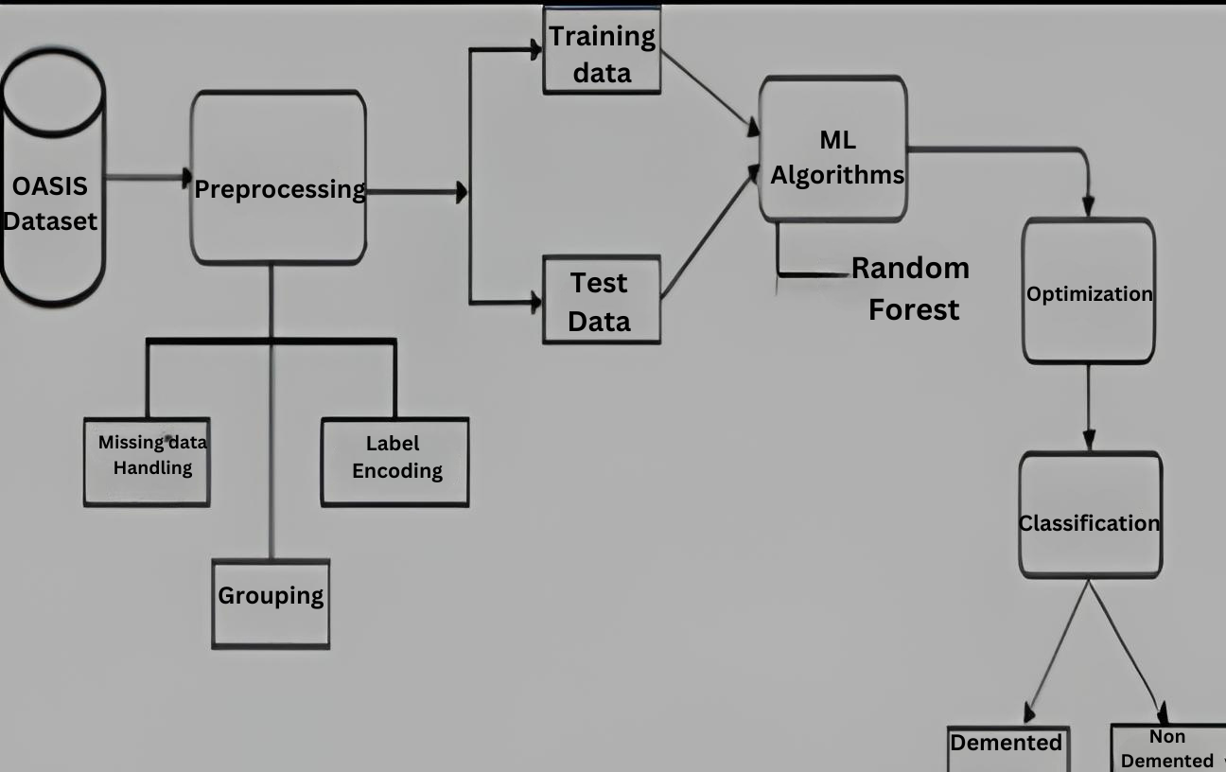
Architecture Diagram
Architecture Diagram(fig-d)

Slide 10
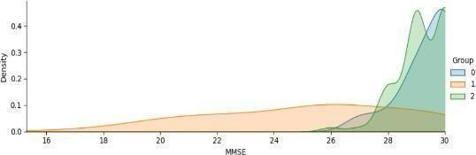
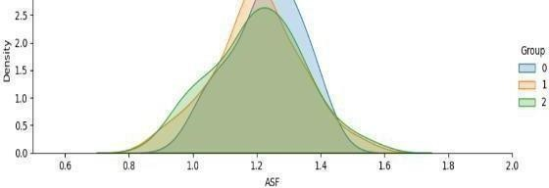
VISUALIZATION AND RESULTS
Kernel Density Estimation (KDE) graph helps visualize data's underlying probability distribution, revealing patterns, peaks, and spread. Using 'MMSE' feature, it effectively estimates density, smoothing data with bandwidth h and kernel K, aiding complex data analysis and interpretation.
Kernel Density Estimation Plot (fig-e)
The distribution of feature values and how they relate to the target variable are shown in FacetGrid KDE graphs. KDE estimate is performed independently on each feature, revealing information about their distributions and possible relationships with the target variable. ‘Group’ and ‘ASF’ factors are used.
Face Grid KDE Plot(fig-f)

Slide 11
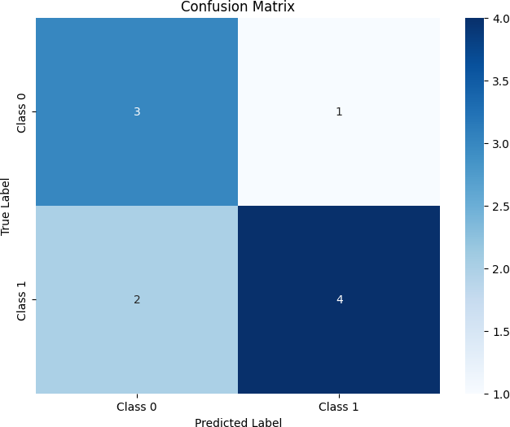
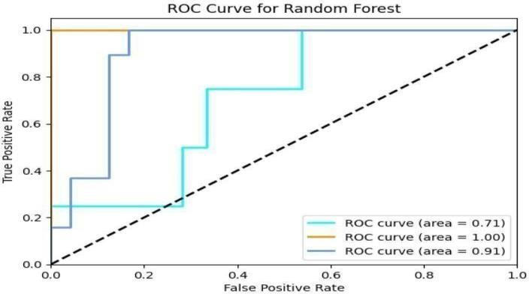
A confusion matrix offers comprehensive insights into model performance across classes, summarizing true positives, true negatives, false positives, and false negatives. Drawing this graph evaluates classification accuracy, highlights misclassifications, and identifies areas for improving model performance.
Confusion matrix(fig-g)
The ROC curve plots true positive rate vs. false positive rate at various thresholds, with higher AUC values indicating better performance. This graph offers a comprehensive single-number evaluation of the model's effectiveness, aiding in comparison and performance assessment.
ROC Graph(fig-h)

Slide 12
CONCLUSION
The Random Forest classifier achieved a strong accuracy of 90.69% in classifying the dataset's classes, supported by well-tuned hyperparameters. However, its precision of 60.87% indicates room for improvement, particularly in correctly identifying positive samples like distinguishing between 'MCI' and 'AD'. Addressing these challenges through further hyperparameter tuning, advanced feature engineering, and exploring alternative ML methods could enhance model performance, crucial for accurate Alzheimer's disease diagnosis.

Slide 13
FUTURE SCOPE
Future work will focus on optimizing feature selection for better interpretability and reduced overfitting, employing robust cross-validation for reliable performance assessment across diverse datasets. Integration of ensemble learning methods may further boost classification accuracy by leveraging combined predictive strengths. Ongoing refinement is essential for developing a reliable tool for medical diagnostics.

Slide 14


Slide 15
MY TEAM
Sowjanya Vuddanti
Shaik Neeha Yasmin
Lakkimsetti Dishasri
Katikala Neela Somanath
Yalla Prasanth

Slide 16


